Slide 1
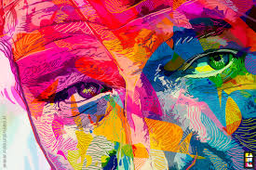
Color is the place where our brain and universe meet.
By: Paul Klee

Slide 2
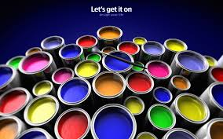
Pre-Color Visualizer For Smartphone

Slide 3
Co-Member’s Naveed Farhan-ul-Haq Khan Supervisor: Dr. Aarij Mahmood Hussaan

Slide 4
Abstract Of Project
Every so often people are profound to know how their rooms will look like after applying a certain color.
we aspire to design a mobile application that can provide people the opportunity to preview their rooms/walls/ceilings, etc , with a certain color before applying in reality.

Slide 5
Introduction
Scope:
Objectives & Goals:
Features:
Over View Of The Model:

Slide 6
Project Description
ENLIGHTENMENT OF THE MODEL
TECHNOLOGY USED
USER INTERFACE DESIGN

Slide 7
Implementations
DELIVERABLE ITEMS
MILESTONES

Slide 8
Scope
This App can be used by Home owners, Color shops, under construction buildings
This apps work on android platform and you can run it on any android device.
Paint industry for showing the customers the effects of their paint on the houses in real-time.

Slide 9
Objectives & Goals
To allow homeowners to pre-visualize the effects of applying different colors on their walls, doors, ceilings, etc.
To be able to change colors of the identified segments.
To change colors keeping into account the light variations.

Slide 10
Features
Some of the features of this application are for user interface and easy to handle the application.
Detection of different segments (walls, doors, ceilings, etc.) in an automatic manner.
Ability to choose colors and apply them to the detected objects.
Ability to apply colors according to the light intensity for more realistic visualization.

Slide 11
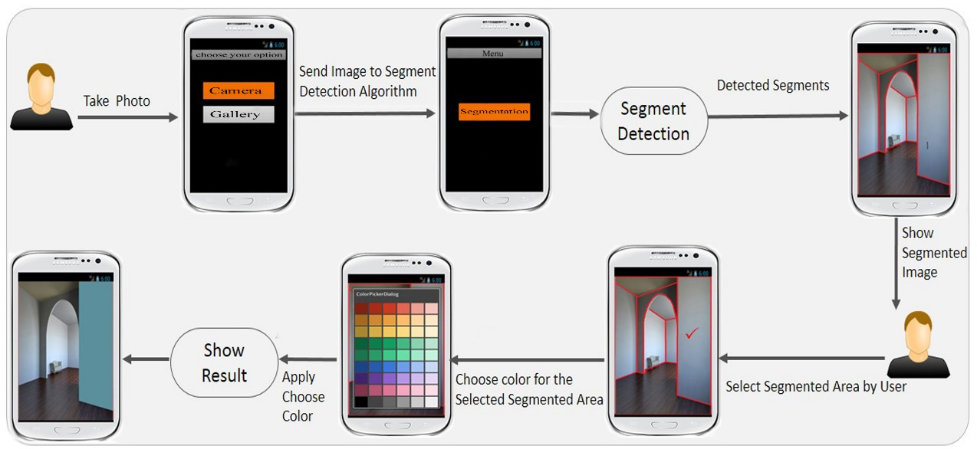
Overview of the Model

Slide 12
Implementation
The app is written in java and xml for design on tools Eclipse 4.2 Kepler.
The core library were use in project was Open CV library for android version 2.4.8.
Another library used was AmbilWarnaColorPicker
The OS for development used was Windows.

Slide 13
Canny Edge Detection
The main algorithm we used from OpenCV library for edge detection is Canny.
Canny edge detection method is one of the more commonly used edge detection method.
The Canny Edge detector was developed by John F. Canny in 1986. Also known to many as the optimal detector, Canny algorithm aims to satisfy three main criteria:
Low error rate: Meaning a good detection of only existent edges.
Good localization: The distance between edge pixels detected and real edge pixels have to be minimized.
Minimal response: Only one detector response per edge.

Slide 14
Steps of Canny Edge Extraction
Apply Gaussian filter to smooth the image in order to remove the noise
Find the intensity gradients of the image
Apply non-maximum suppression to get rid of spurious response to edge detection
Apply double threshold to determine potential edges
Track edge by hysteresis: Finalize the detection of edges by suppressing all the other edges that are weak and not connected to strong edges.
Notes:
An image gradient is a directional change in the intensity or color in an image. Image gradients may be used to extract information from images.

Slide 15
Was Canny Edge detection Enough?
There is nothing like perfect edge detection which will extract 100% edges from an image.
So why canny only?
Well, we did apply “Sobel”, “Laplacian ” “Guassian”, “GrabCut”, “Water Shed”.
Some tinkering in canny edge detection carried out better results than others.

Slide 16
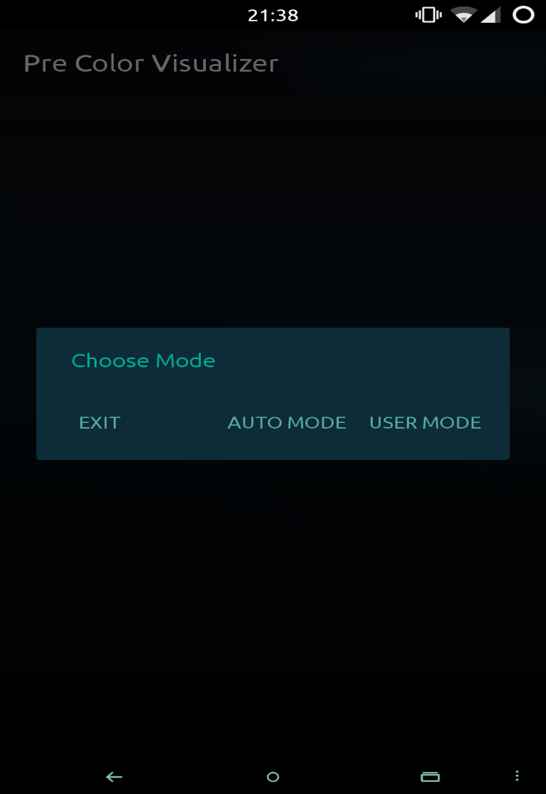
App Overview
For user interaction we used a pop-up dialog which shown after app launch.
There are two modes in app
AUTO MODE
USER MODE

Slide 17
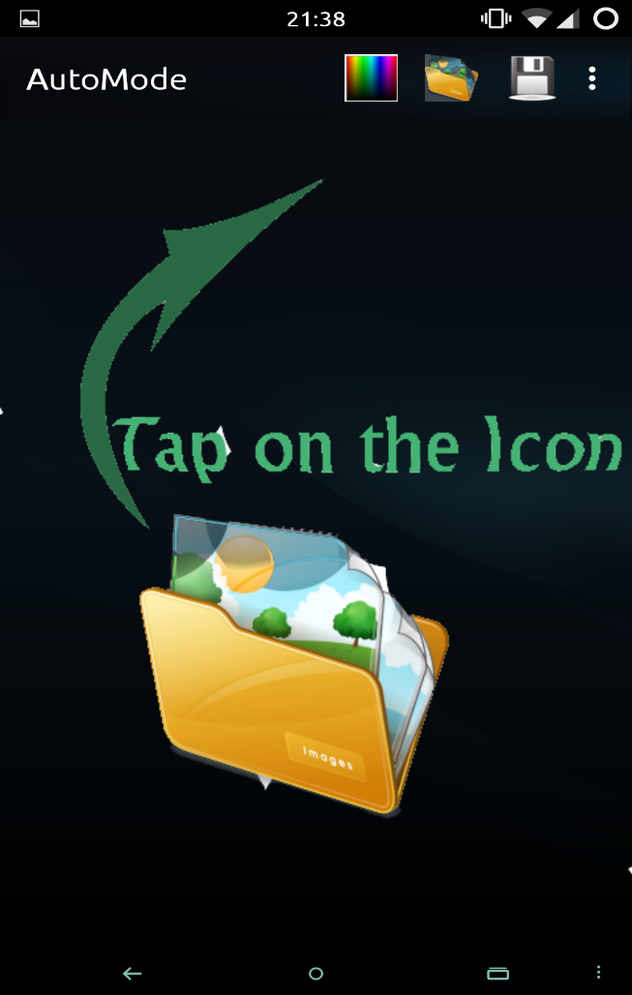
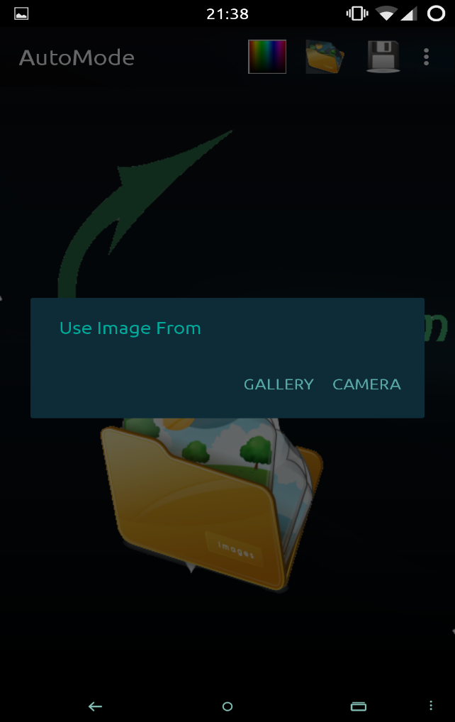
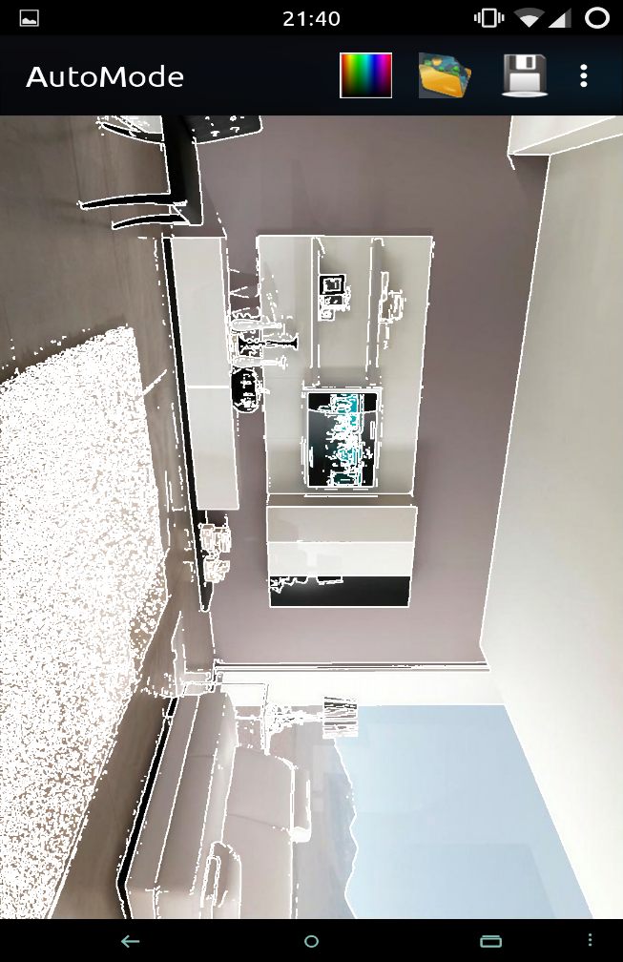
AUTO MODE
After tapping on Auto Mode and upon choosing an image we’ll have an image with edges on it.

Slide 18
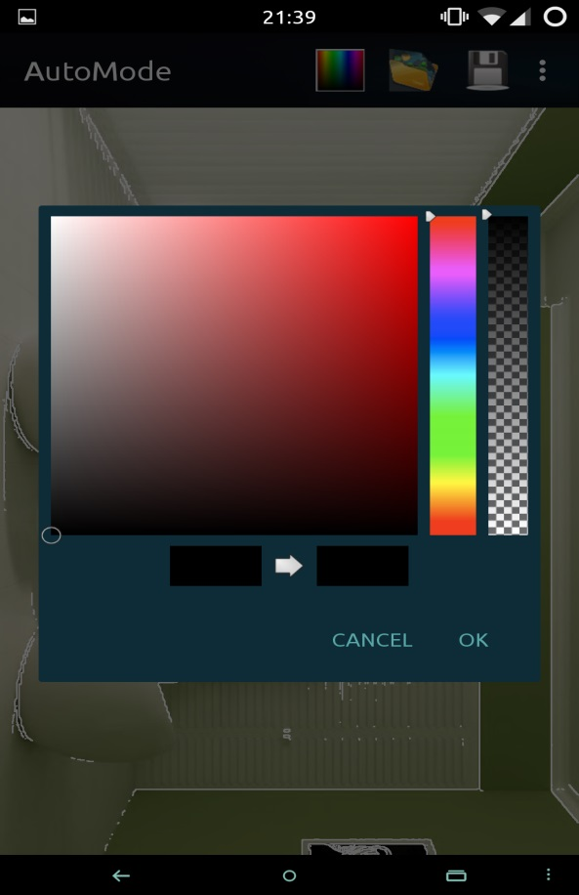
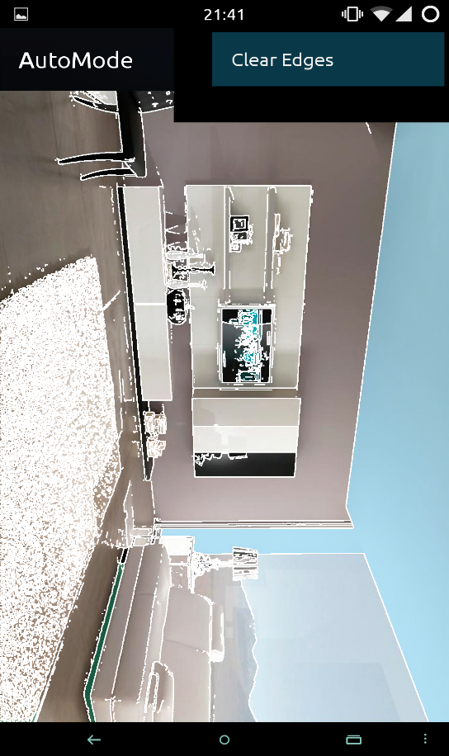
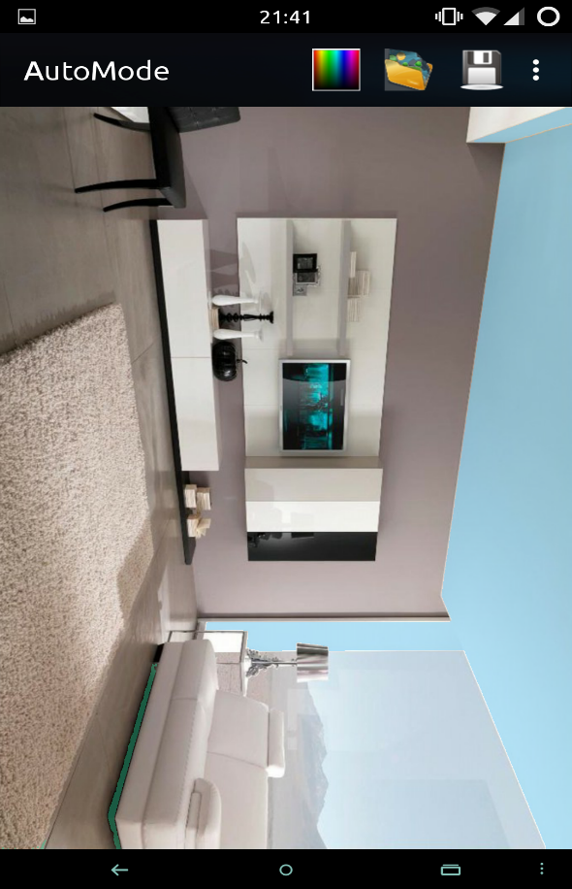
Cont.
After getting edges on the image we can now select color from the picker and apply it on the specific segment.

Slide 19
USER MODE
Why User mode when we have Auto mode?
So there is leverage to the user that they can draw their own edges and then color it.
Again you had to choose the image from gallery or take a new one and then draw edges on it but tapping on top left pencil icon.

Slide 20
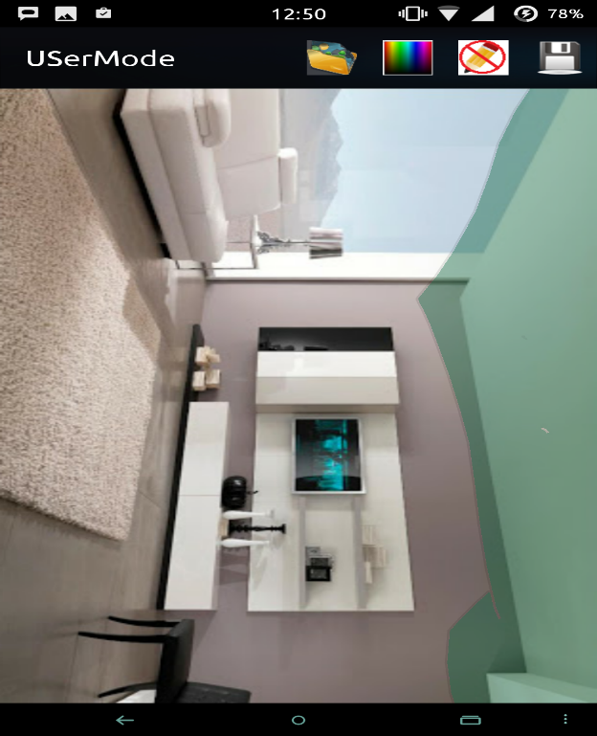
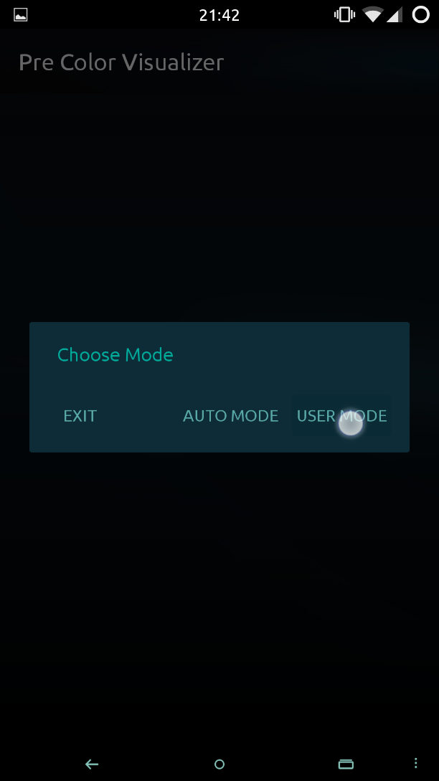
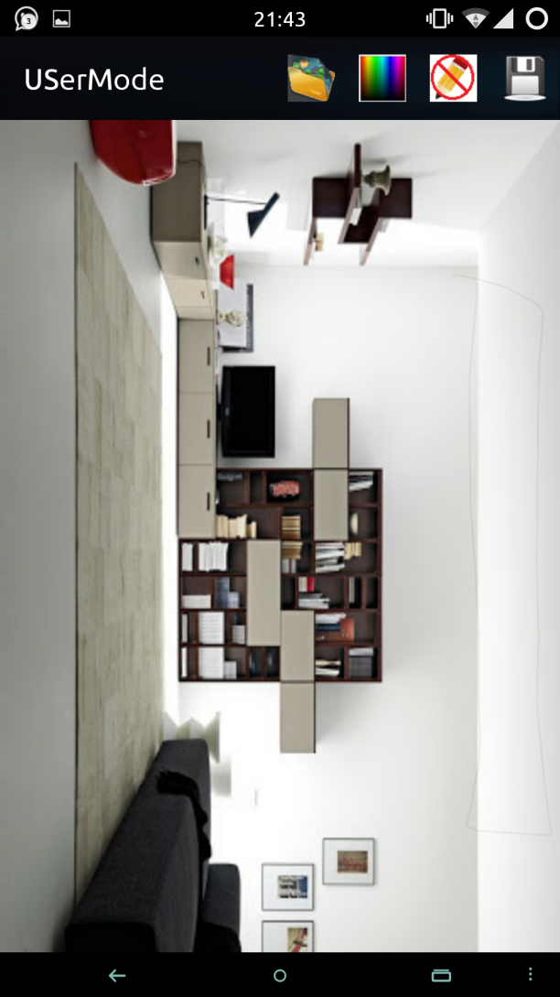
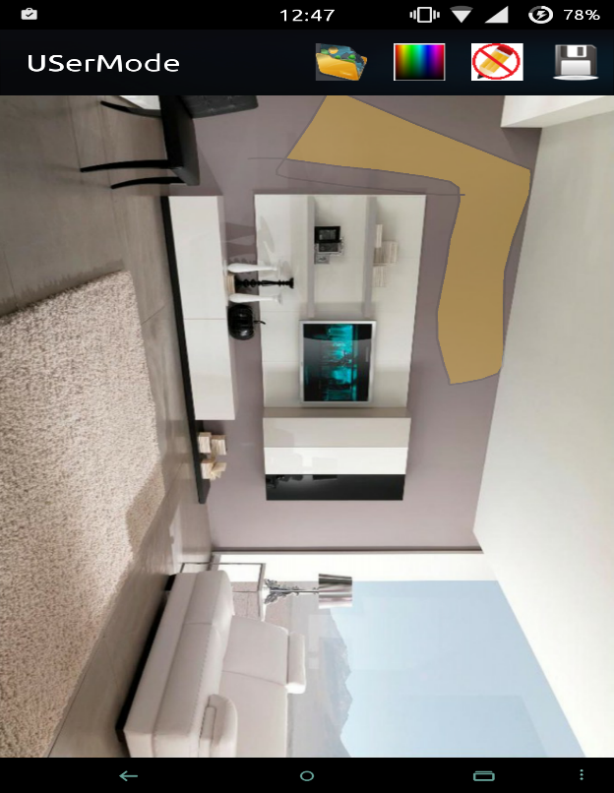
Cont.

Slide 21
Code Overview
The two modes in Android are two different activities with some same methods like saving, showing of Color Picker, and navigating to gallery and camera.
Auto mode uses OpenCV library’s Canny Edge Detection method, Gaussian Blur method and Flood fill method.
User Mode uses canvas methods to draw on a view, Flood fill for filling the segment.

Slide 22
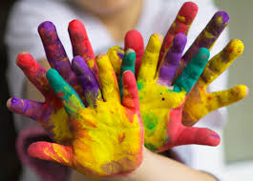
Conclusion
Pre-visualization of your painted walls, ceils etc.
This tool will be helpful for pre planning of a room and Pre-visualization of your painted walls, ceils etc

Slide 23


Slide 24



